Slide 1


A Great British Bake-Off Database
Alexis Bloor, Benji Manning, Hannah Hill

Slide 2




E
xtract
T
ransform
L
oad

Slide 3



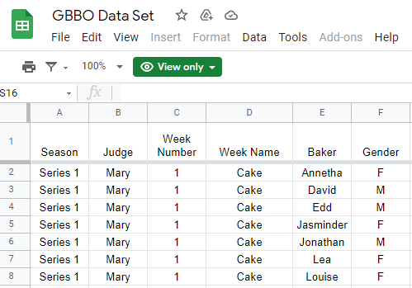
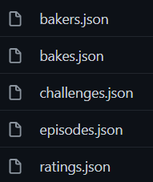

Extract data from multiple sources in multiple formats
Apreshill GitHub Page
Nick Ahamed Google Sheet

Slide 4
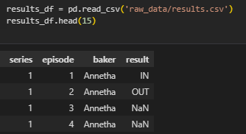
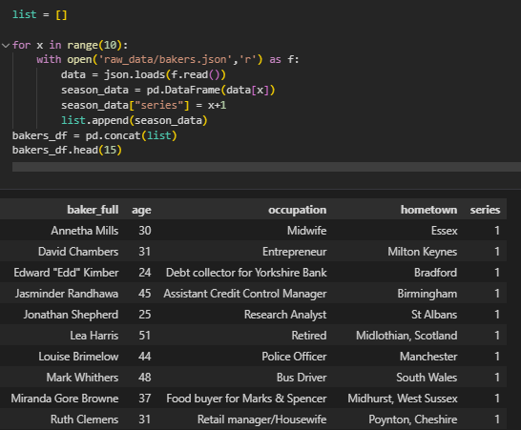
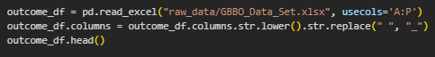
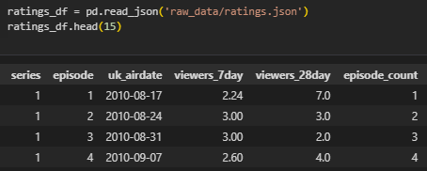
Extract data from multiple sources in multiple formats

Slide 5

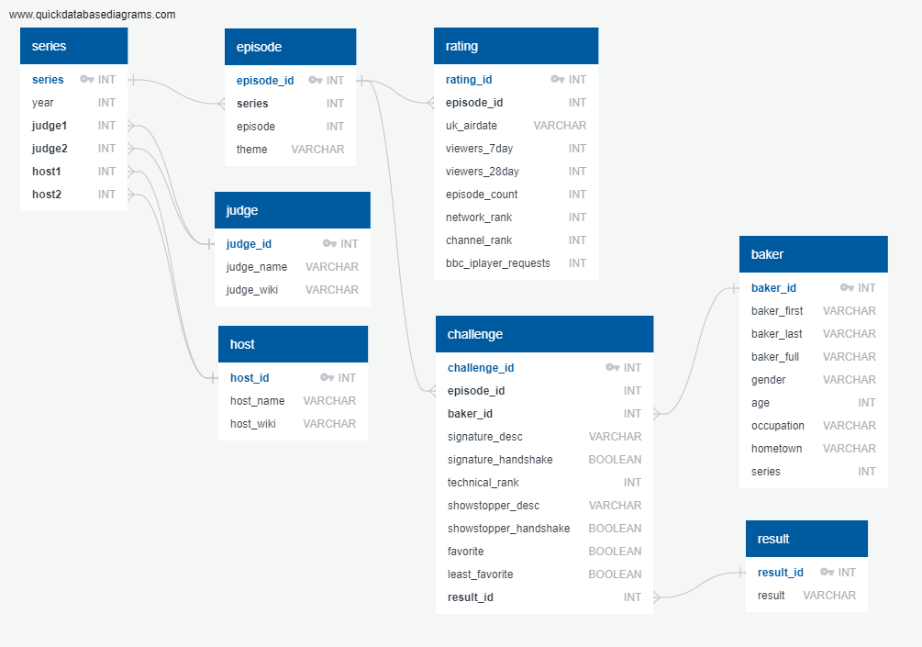

Design structured database using Normal Form

Slide 6
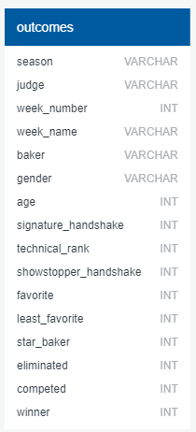
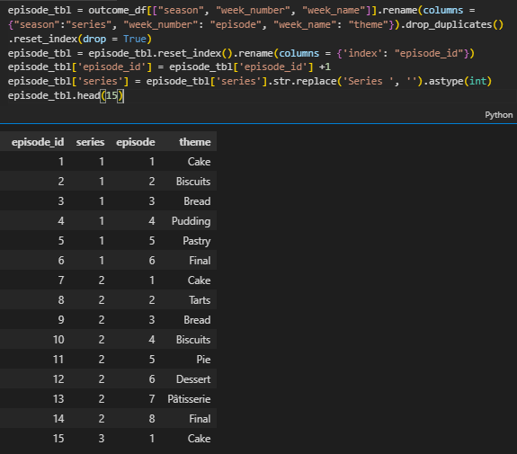
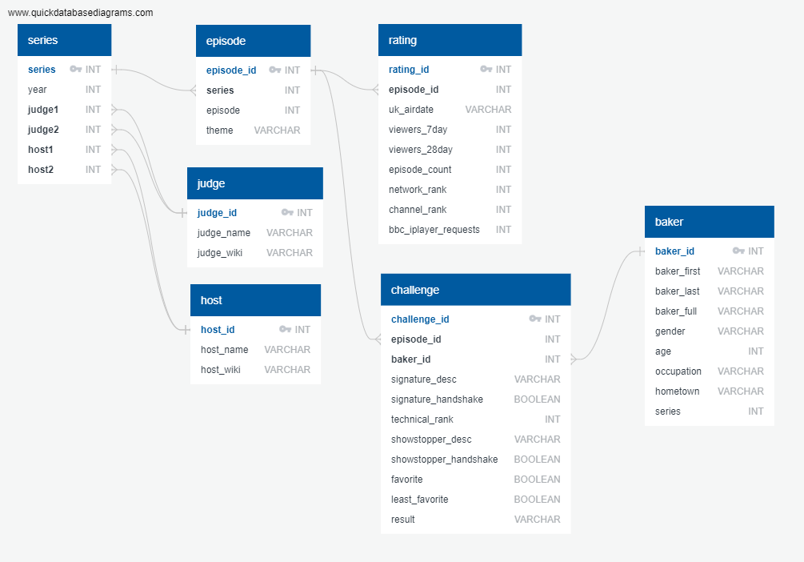

Transform data into tables based on ERD

Slide 7
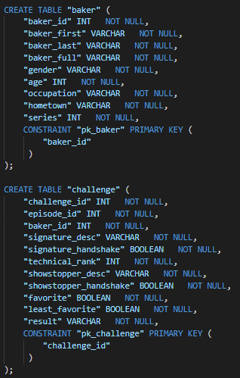
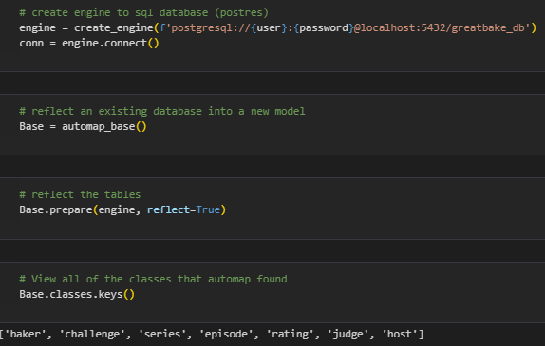
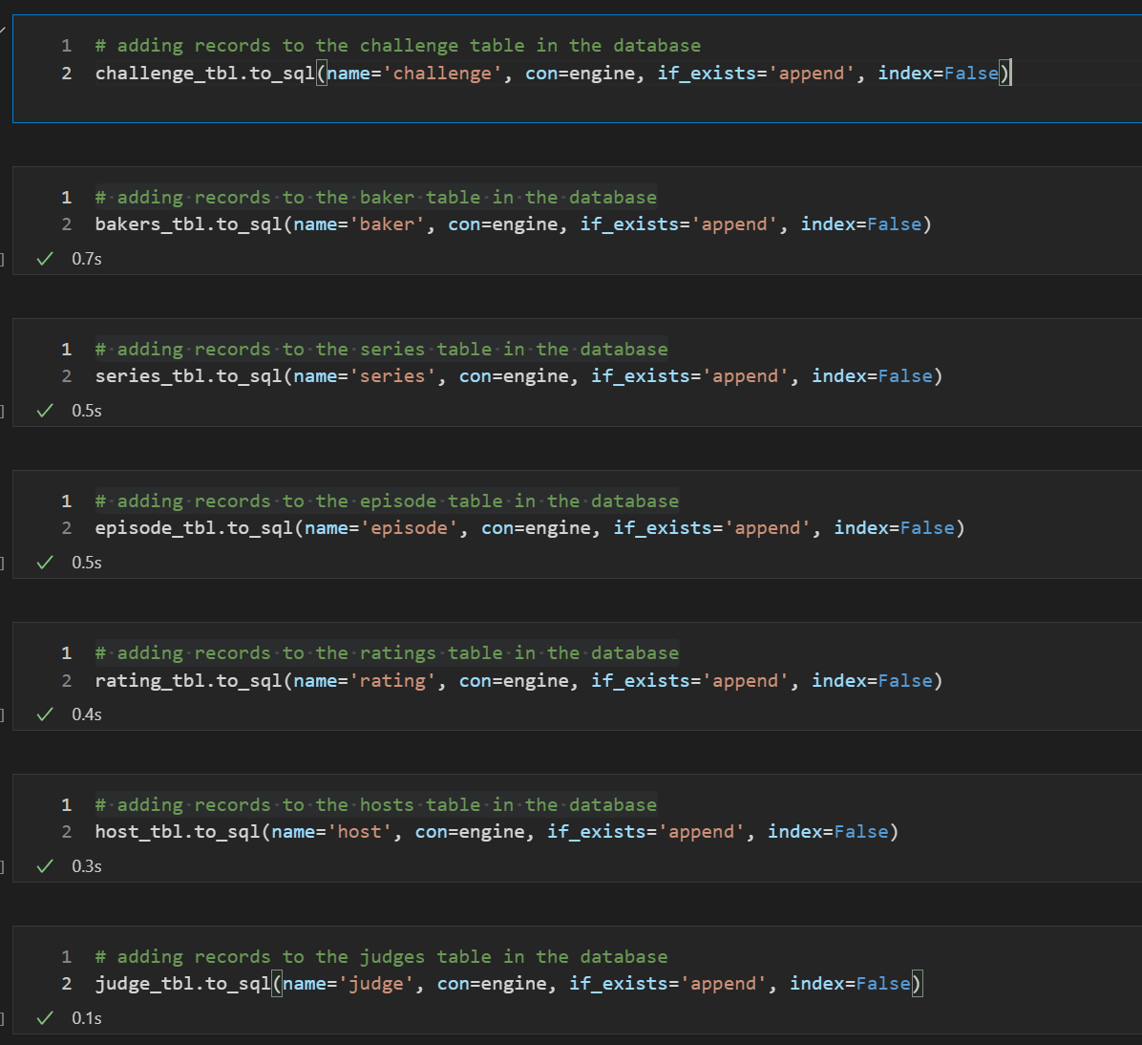

Load data into database

Slide 8

Questions?

